Slide 1
Fluid dynamics
blubblubblubblubblubblubblub

Slide 2
Fluids

Slide 3
What is a fluid?
What do you think are some fluids?
Water
Liquids
“A substance, as a liquid or gas, that is capable of flowing and that changes its shape at a steady rate when acted upon by a force tending to change its shape” - Merriam Webster
Gases are fluids?
Anything that changes its shape at a steady rate due to forces

Slide 4
Energy

Slide 5
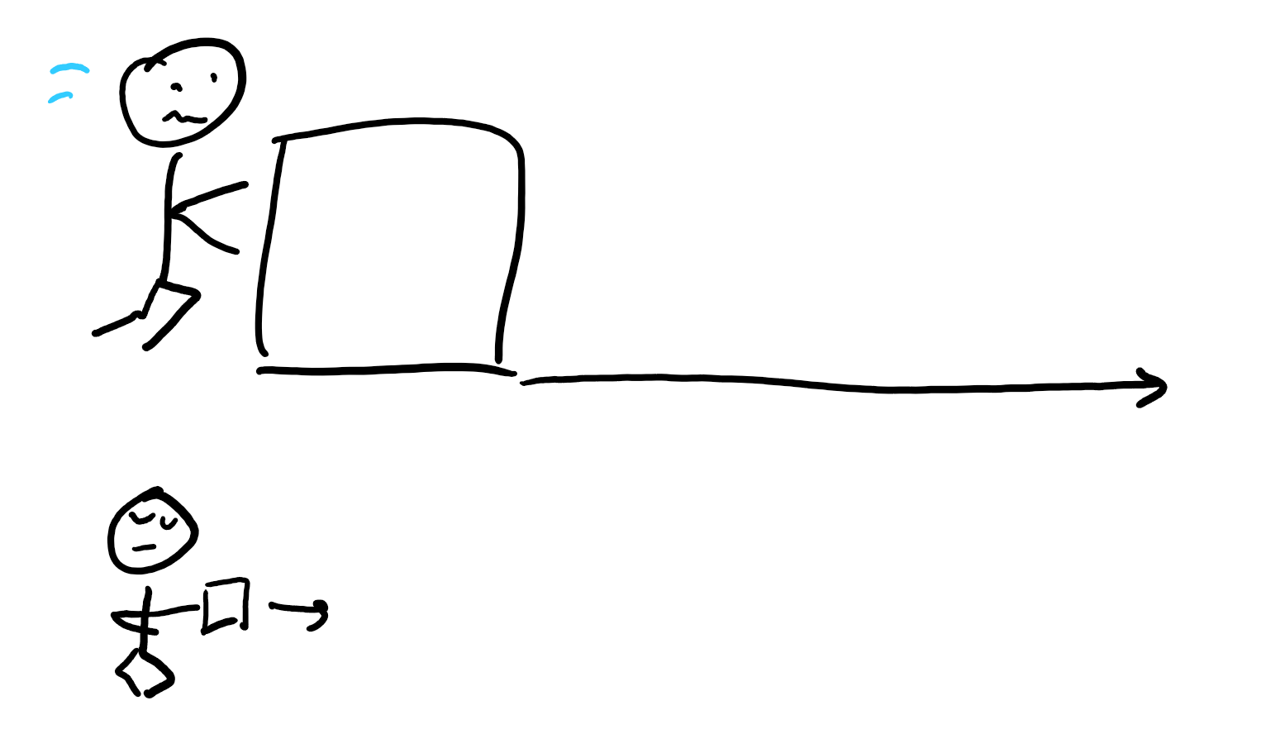
How to calculate energy?
Work is force times distance.
I get more tired pushing a box with more “force.”
I get more tired pushing a box further.
Energy is the ability to do “work.”

Slide 6
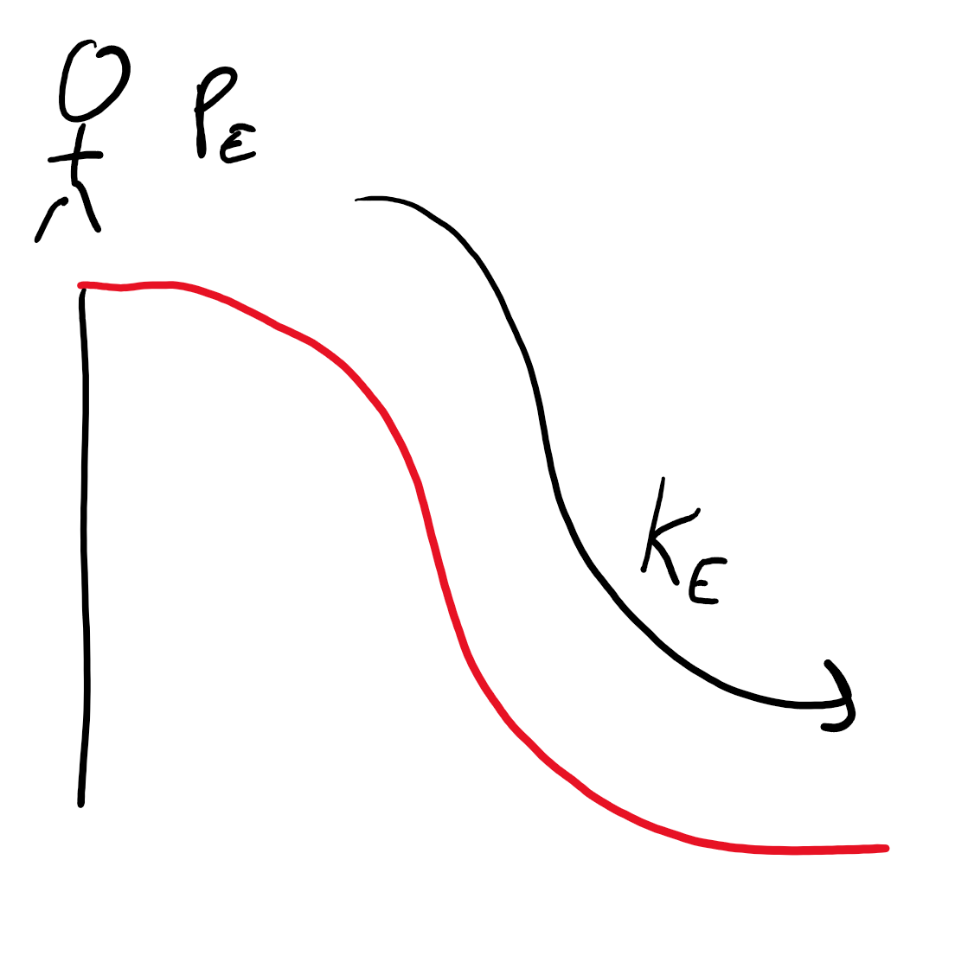
Two types of energy
Potential energy
Kinetic energy
Now guess what they mean!

Slide 7
Good guesses but you’re wrong (unless someone got it right, then I look dum)
Kinetic: Has to do with motion. When objects are zoomin-zoomin, they have Kinetic Energy.
Potential: Energy based on position. Gives objects the “potential” to move.
Me on top of a slide has “potential” energy because I have the opportunity to jump down the stairs leading up to the slide and fall speedily to the ground (“kinetic” energy).

Slide 8
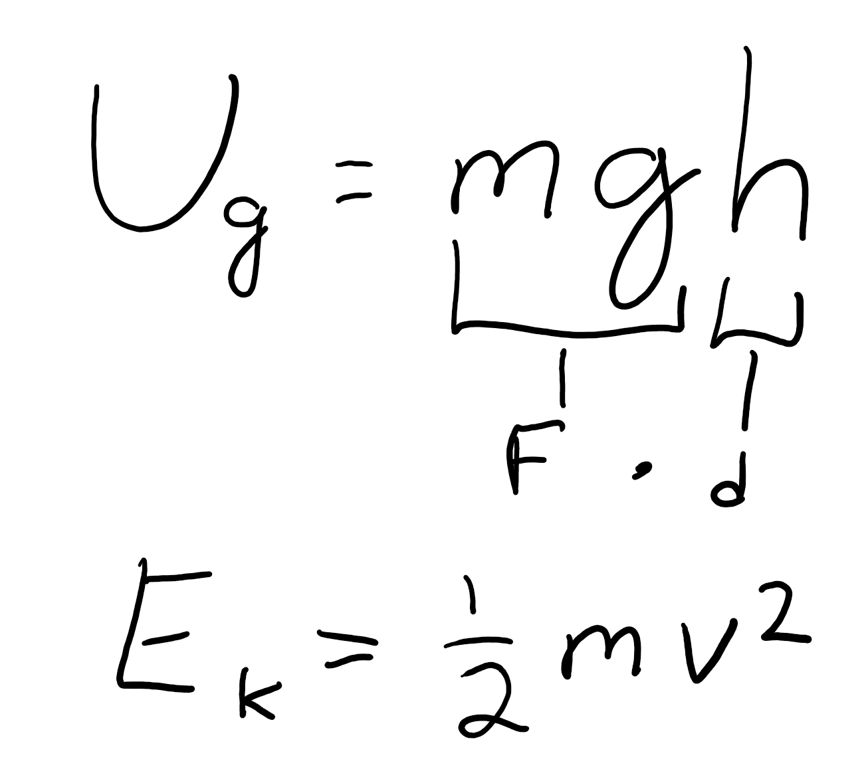
Spoopy equations
Don’t memorize, too hard
Just keep them in mind, or write them down for reference

Slide 9
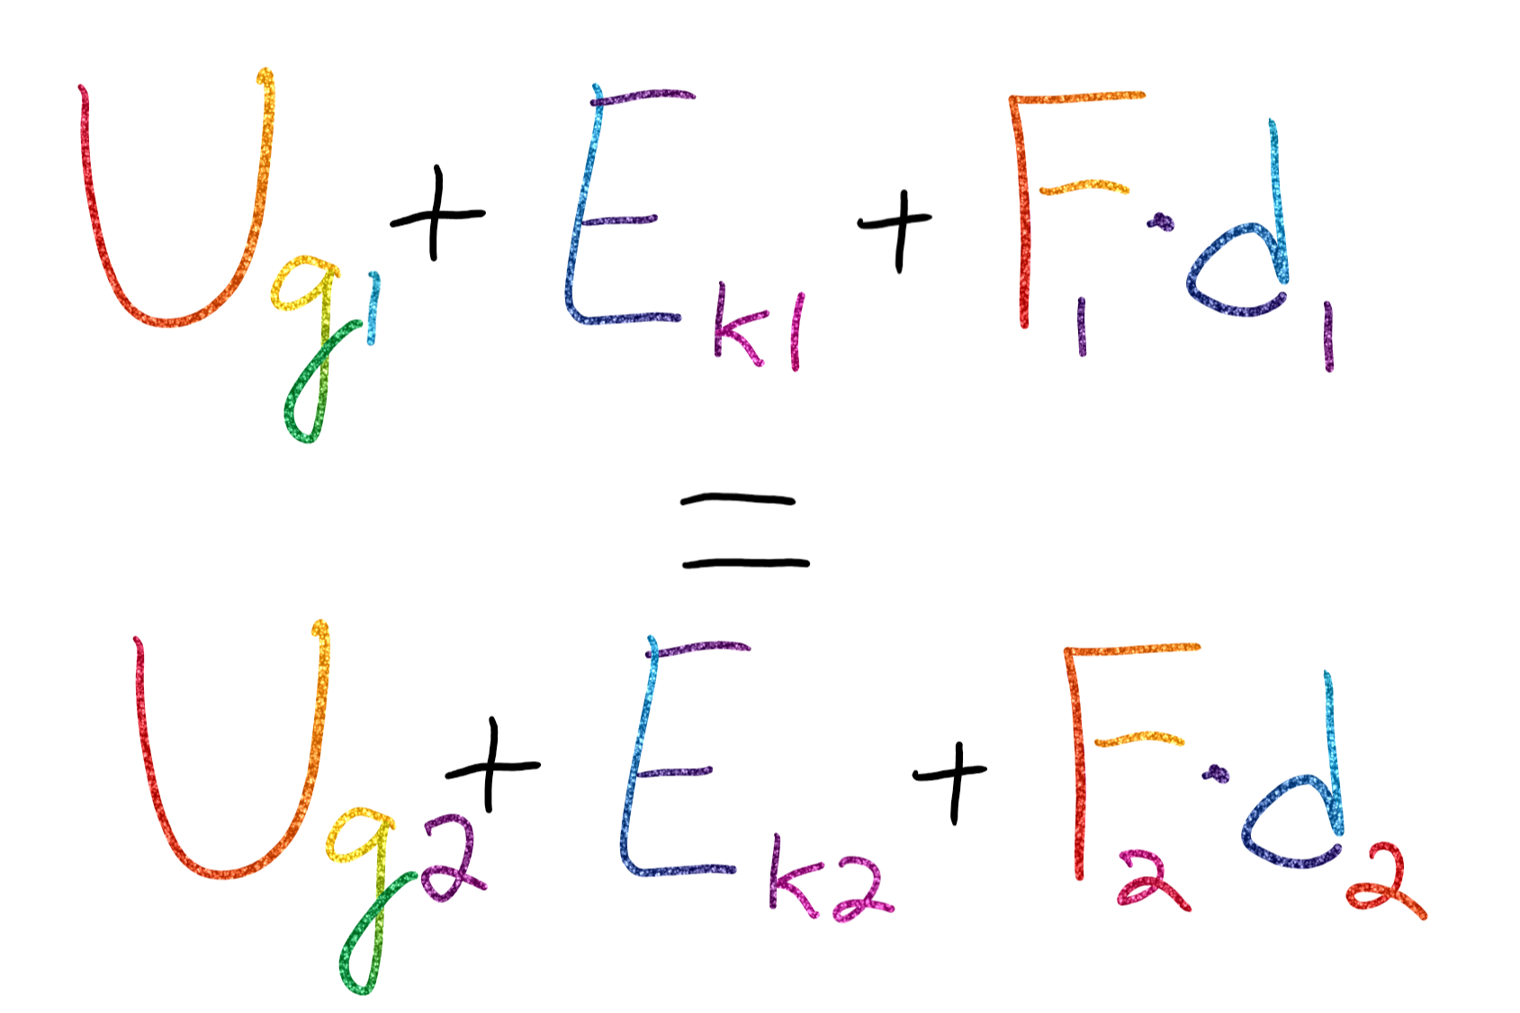
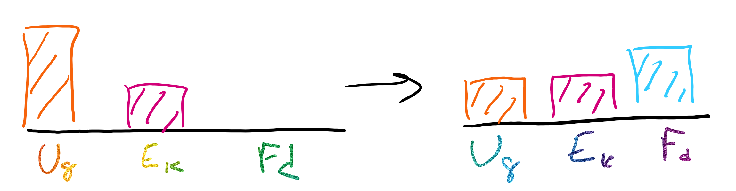
Energy is CONSERVED
If we start with some amount of energy, we end up with the same amount of energy, even though the type of energy can change.

Slide 10
Pressure

Slide 11
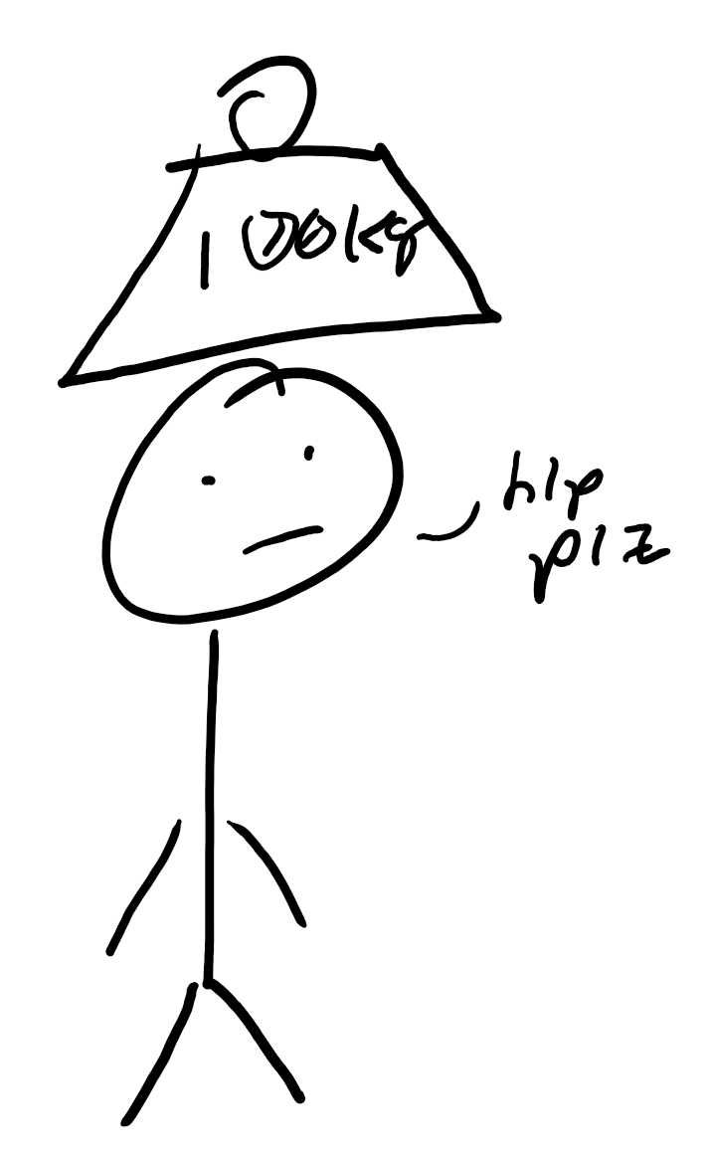
Pressure on fluids
Pressure: How much force per unit area on a fluid
F/A (Force divided by Area)
Liquids are “incompressible”
Like, try to squeeze water, I dare you; you can’t see, boom, proven
Pressurized CO2 in a can of soda/pop/coke/however you want to say it

Slide 12
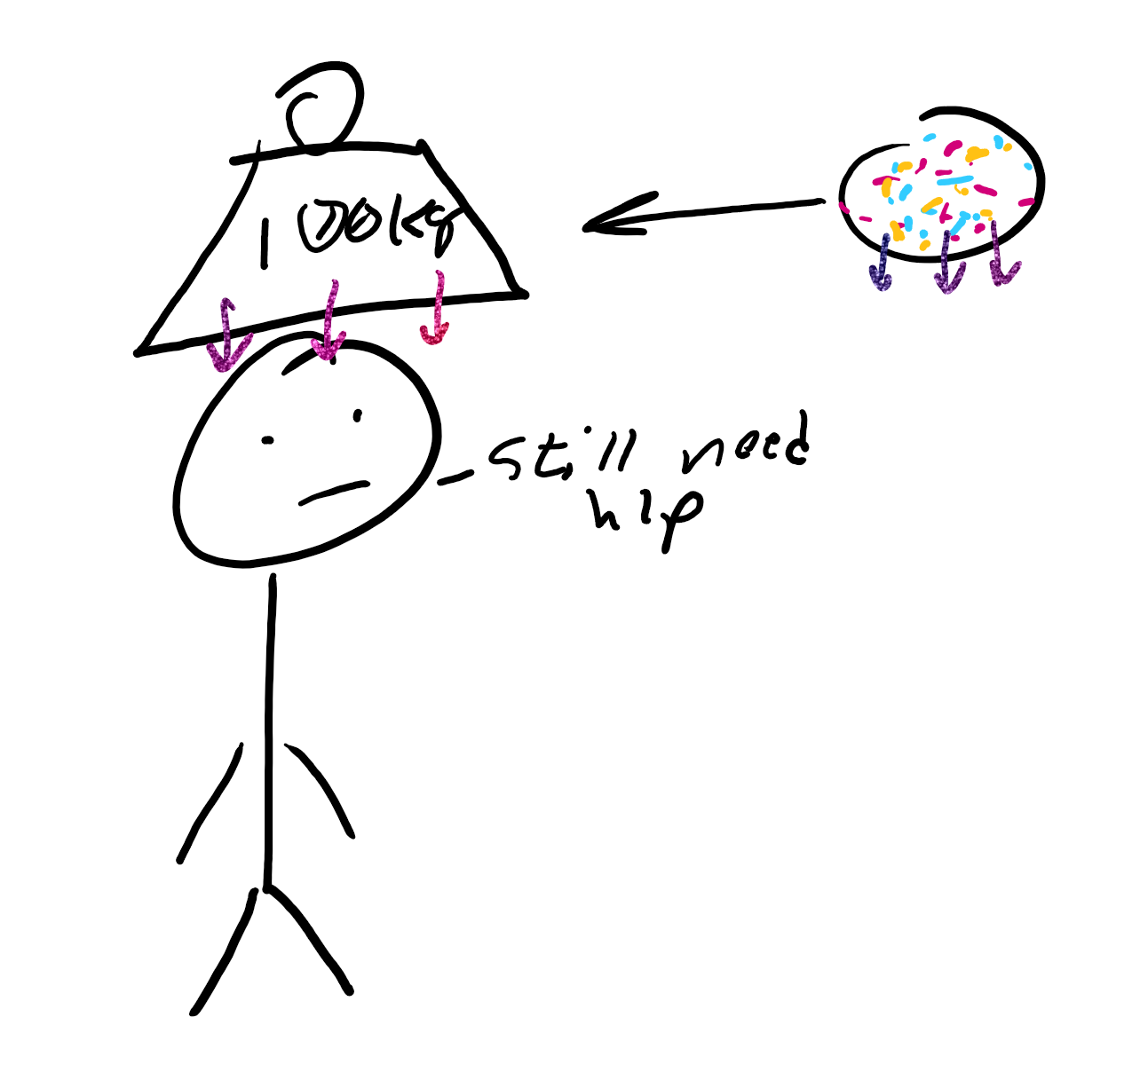
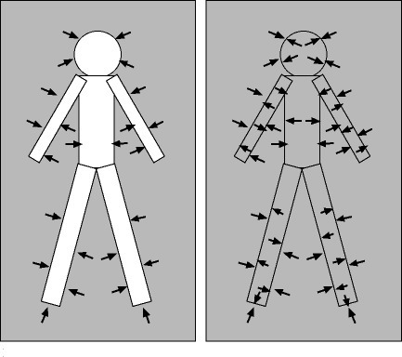
Pressure and Depth
Pressure can be caused by particles above (bc they push down on u)
Your body is facing pressure from the air all the way from your shoulders to the sky
Why are we not crushed?
We have air in our bodies that counteract this with its own pressure, so there is no pressure difference
Only pressure DIFFERENCES can causes force

Slide 13
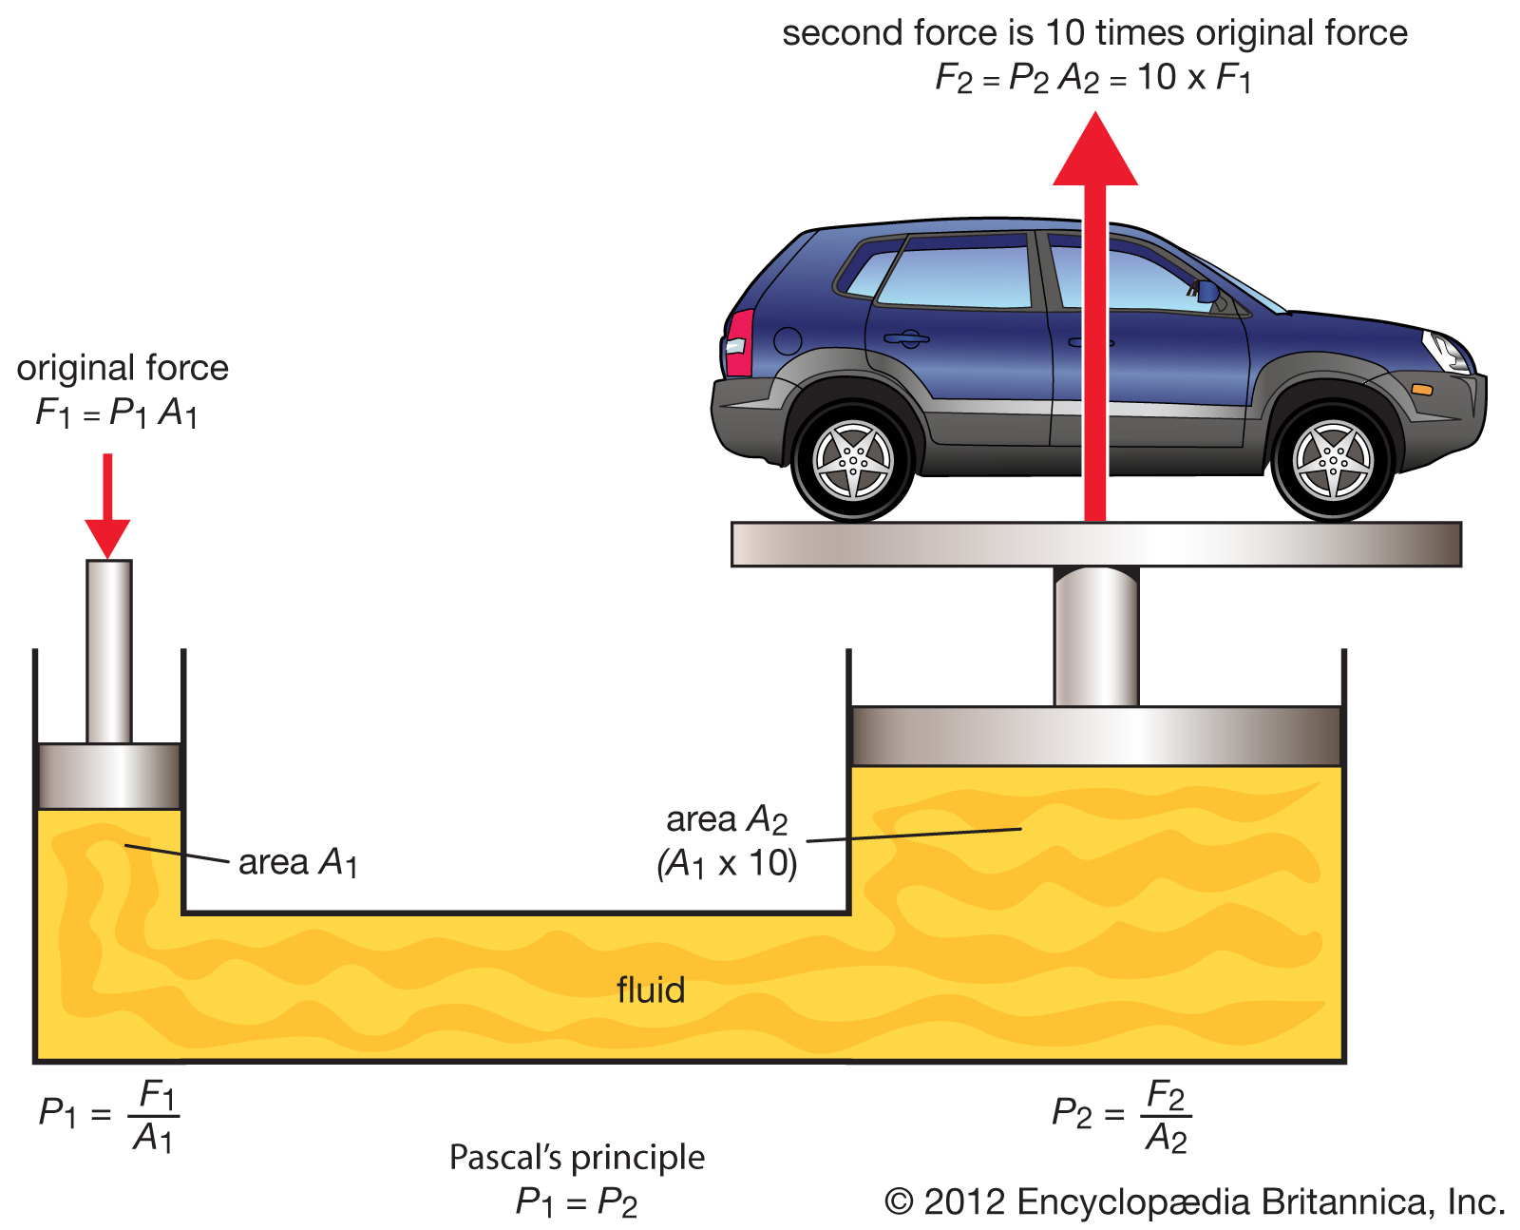
Pascal’s Principle
“A change in pressure at any point in an enclosed fluid at rest is transmitted undiminished to all points in the fluid”
What does it mean?
If we have a pool of water and increase the pressure air exerts on the water, the water everywhere will increase in pressure

Slide 14
Review
Is air a fluid? Why or why not?
What are a couple of properties of fluids?
Why don’t our bodies get crushed under atmospheric pressure?
Why do hydraulic lifts work?

Slide 15
Bernoulli’s Law

Slide 16
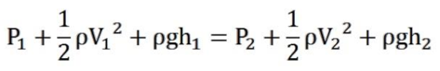
Bernoulli's Law
So, what does this mean?
Second term is “kinetic energy”
Third term is “potential energy”
Pressure is first term
Pressure plus kinetic energy plus potential energy is constant

Slide 17
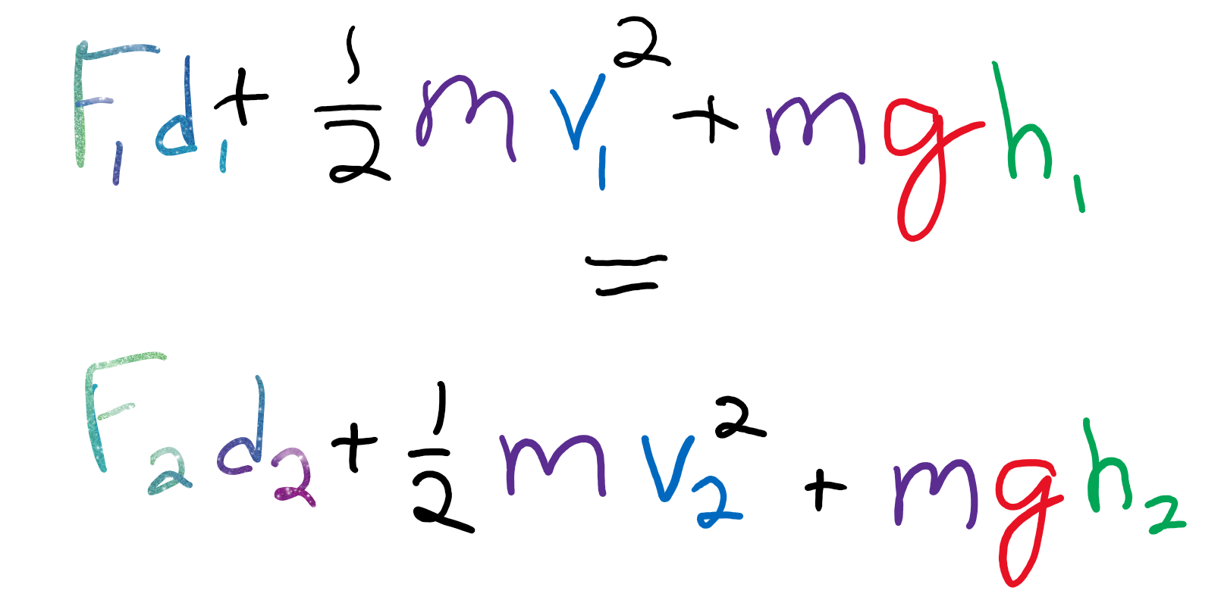
In terms we can understand
Multiply every term by volume!

Slide 18
Energy and Pressure
The more energy, potential and kinetic, the less pressure
Take two empty soda cans
Blow between them,they will get closer
Why?
Higher speed means more kinetic energy
More kinetic energy means less pressure
Cans move toward low pressure zones

Slide 19
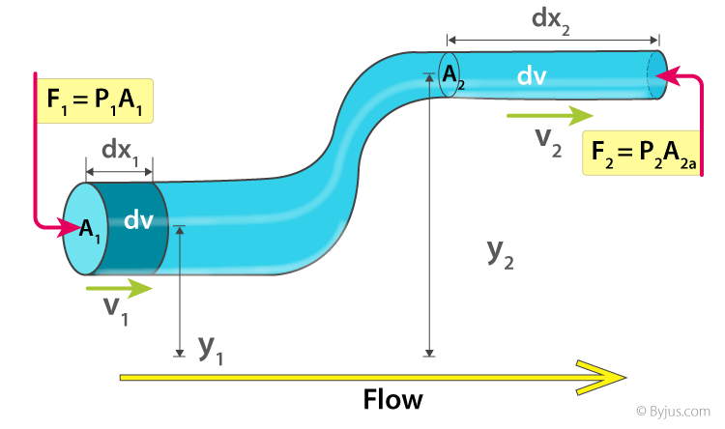
The Potential energy Example
Pipes with a differing thickness and heights
Velocity and this KE increases due to decreased size
PE increases due to height increase
Pressure is especially low

Slide 20
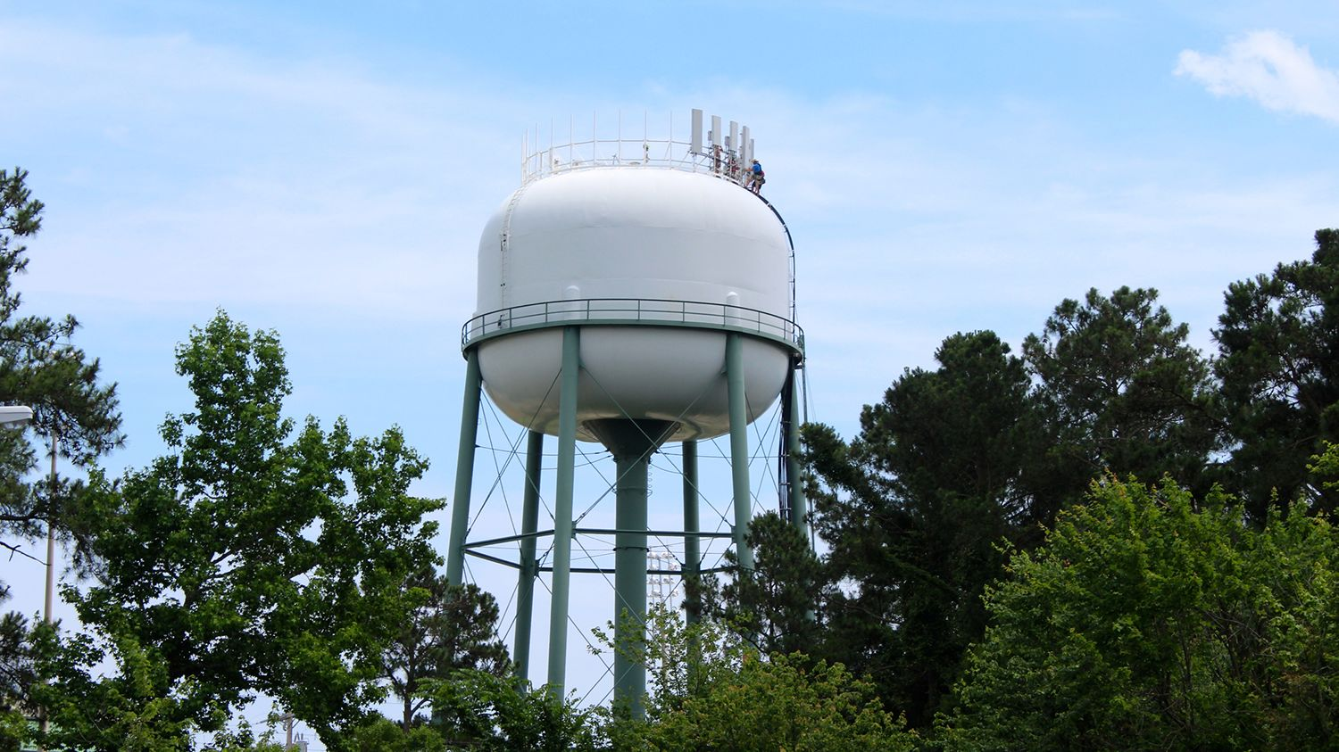
The Principle
Bernoulli's principle states that an increase in the speed of a fluid occurs simultaneously with a decrease in static pressure or a decrease in the fluid's potential energy
“Fast moving air creates spots of low pressure”
Like we said earlier, the trade off for more energy is pressure
Water towers?

Slide 21
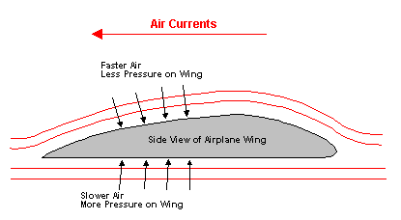
Applications
Drafting
You can “feel” someone else's draft since the high velocity air behind them makes it low pressure by Bernoulli's
Airplanes?
You may have heard Bernoulli’s causes air planes to fly but that is a lie

Slide 22
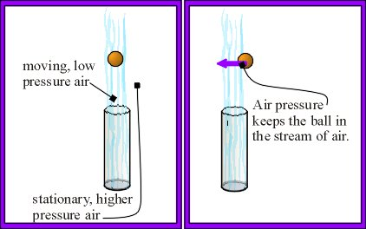
Floating Ping Pong Ball?
With Bernoulli's you can get a floating ping pong ball in your own room!
Materials:
One Ping Pong Ball
One Hair Dryer
Open the hair dryer and set the Ping Pong ball in the center of it! The hair dryer speeds the air up increasing the energy, and thus dropping the pressure, forcing the ball into the hair dryer air.

Slide 23
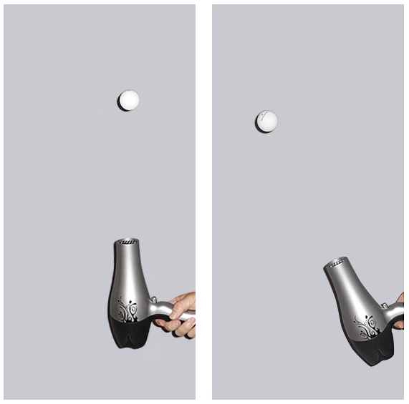
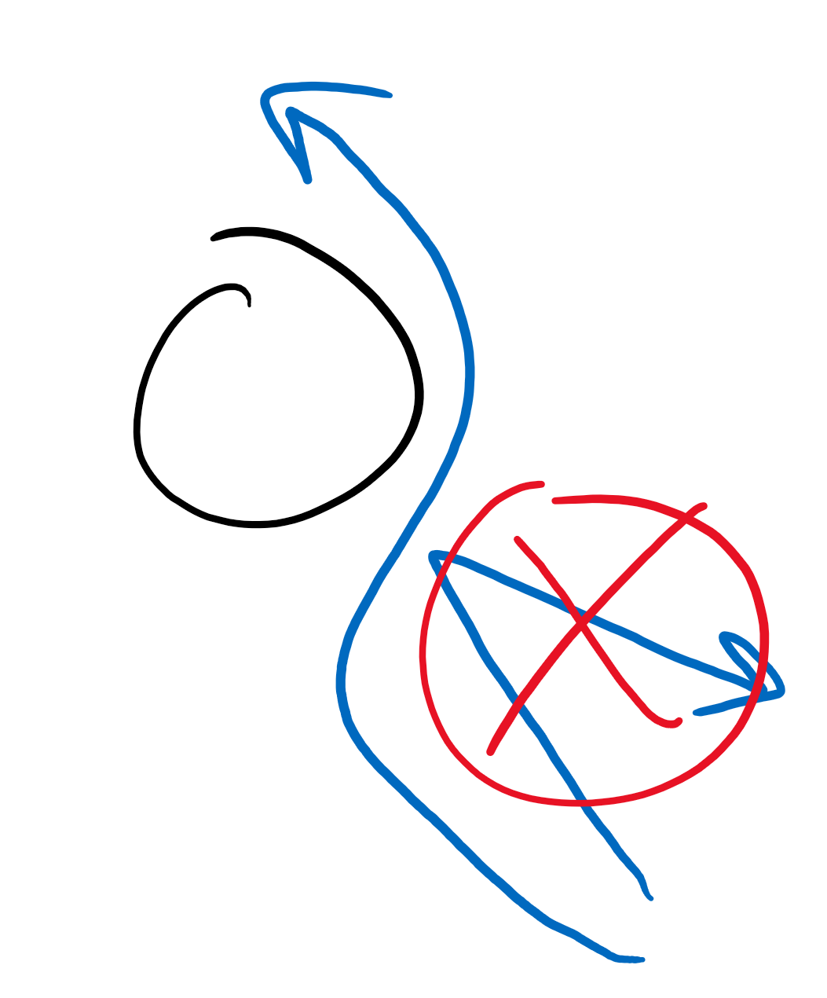
Why do da air do da stick?
Wait if the air is “pushing” on the ball, if I tilt my hairdryer to the left, the ball should fall off right?
Heck no. If you’ve been to the Science Museum, there’s a giant hairdryer thingy for balls, and you can tilt that all you want and the ball still doesn’t fall off the hairdryer.
This is called the “Coanda effect”

Slide 24
Review
What does Bernoulli's Principle say?
What are some of its uses?
Does the speed of a fluid affect pressure?
Does a height change increase affect pressure?

